Slide 1
Data on Texas Car Accidents in 2013
By: Alexander Olvera

Slide 2
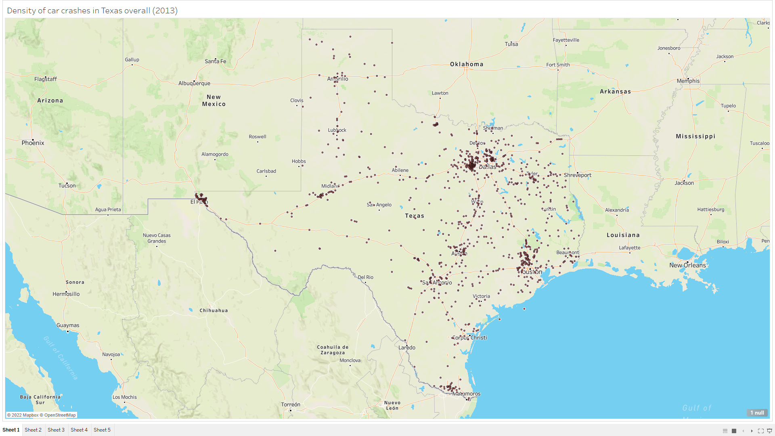

Slide 3
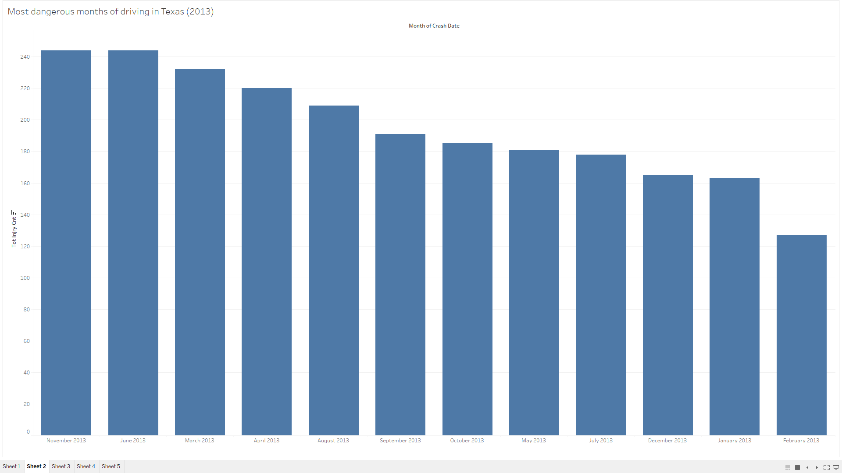

Slide 4
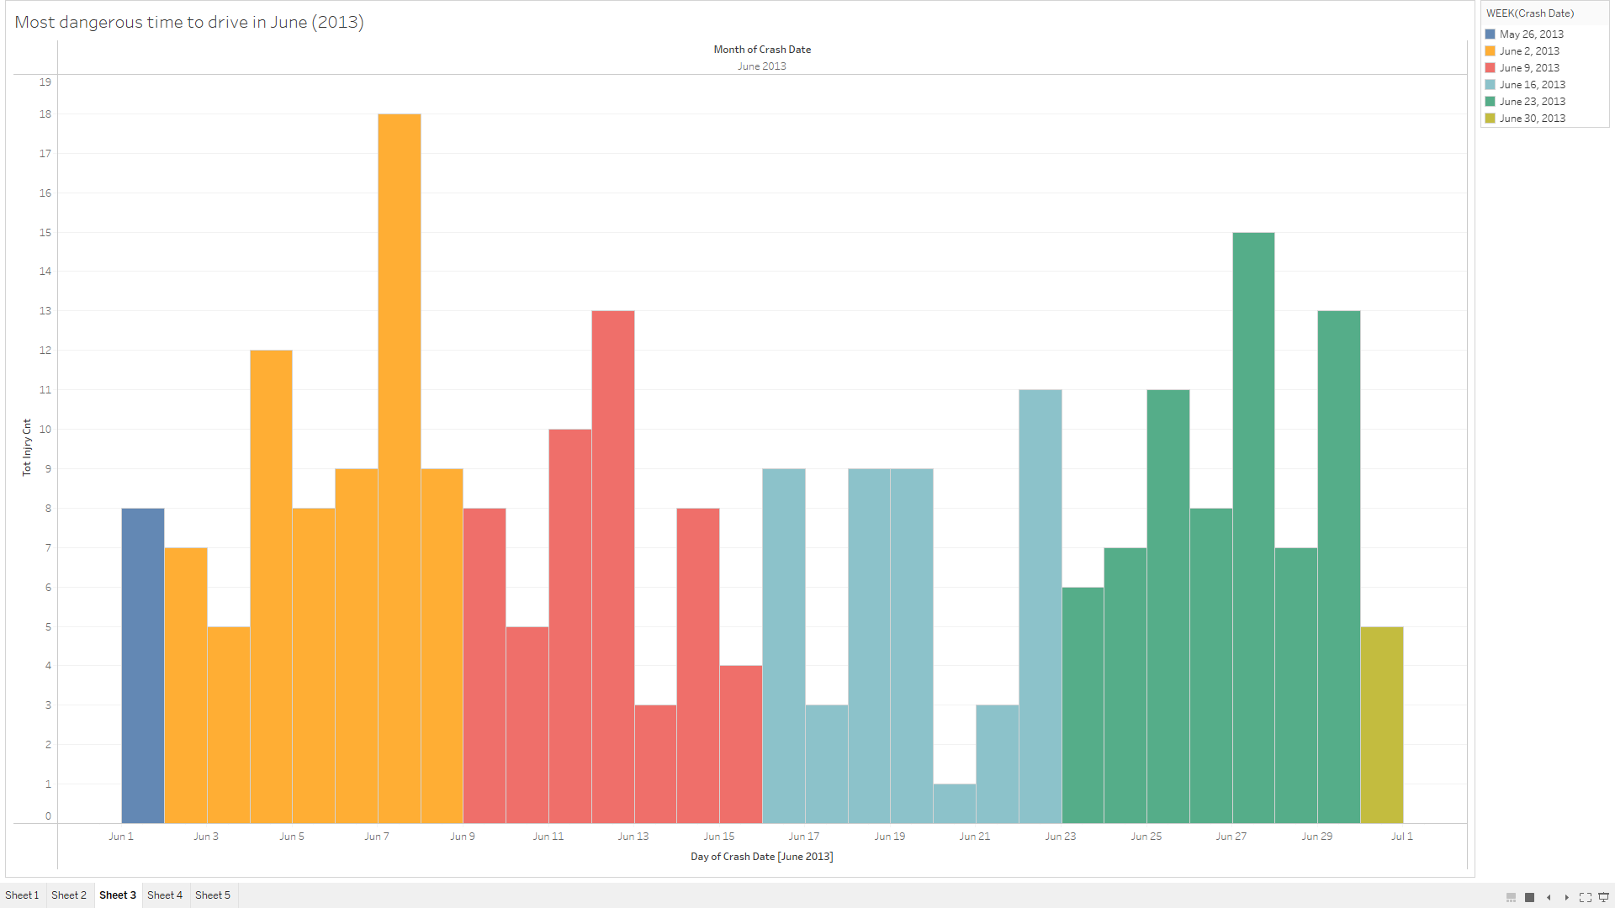

Slide 5
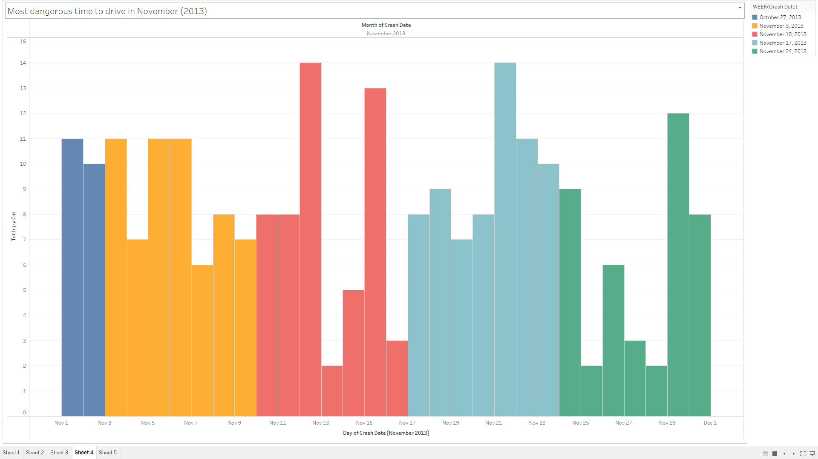

Slide 6
